Slide 1
Bond 2020
Community Update
Brackenridge High School
Fox Tech High School
Bonham Primary @ Green
Feb. 5, 2025

Slide 2
Purpose of Today’s Meeting
Bond 2020 Program Update
Major renovation updates for:
Brackenridge High School
Fox Tech High School
Bonham Primary @ Green
Facility Condition Assessment and master planning

Slide 3
Bond 2020 Approval
In November 2020, voters approved
two propositions totaling $1.3 billion:
PROP A
$1.21 billion for:
Campus renovations/upgrades, including HVAC upgrades
Security upgrades at all schools
Replacement of air-conditioning chillers more than 15 years old at schools not receiving major renovations
New school models
PROP B
$90 million for technology upgrades for all schools

Slide 4
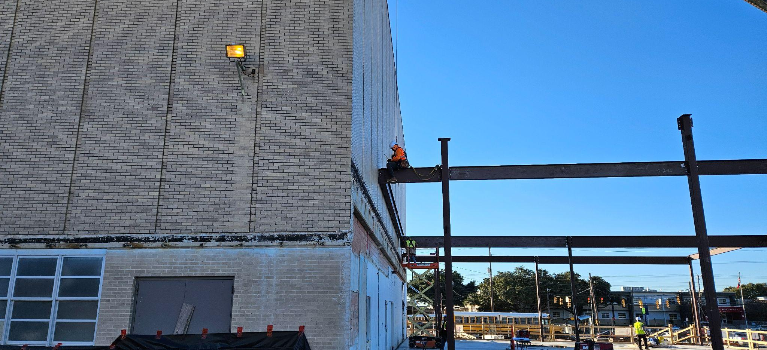
Bond 2020 Planning
Renovation projects were planned pre-pandemic using standard estimates
of 4%-5% for inflation

Slide 5
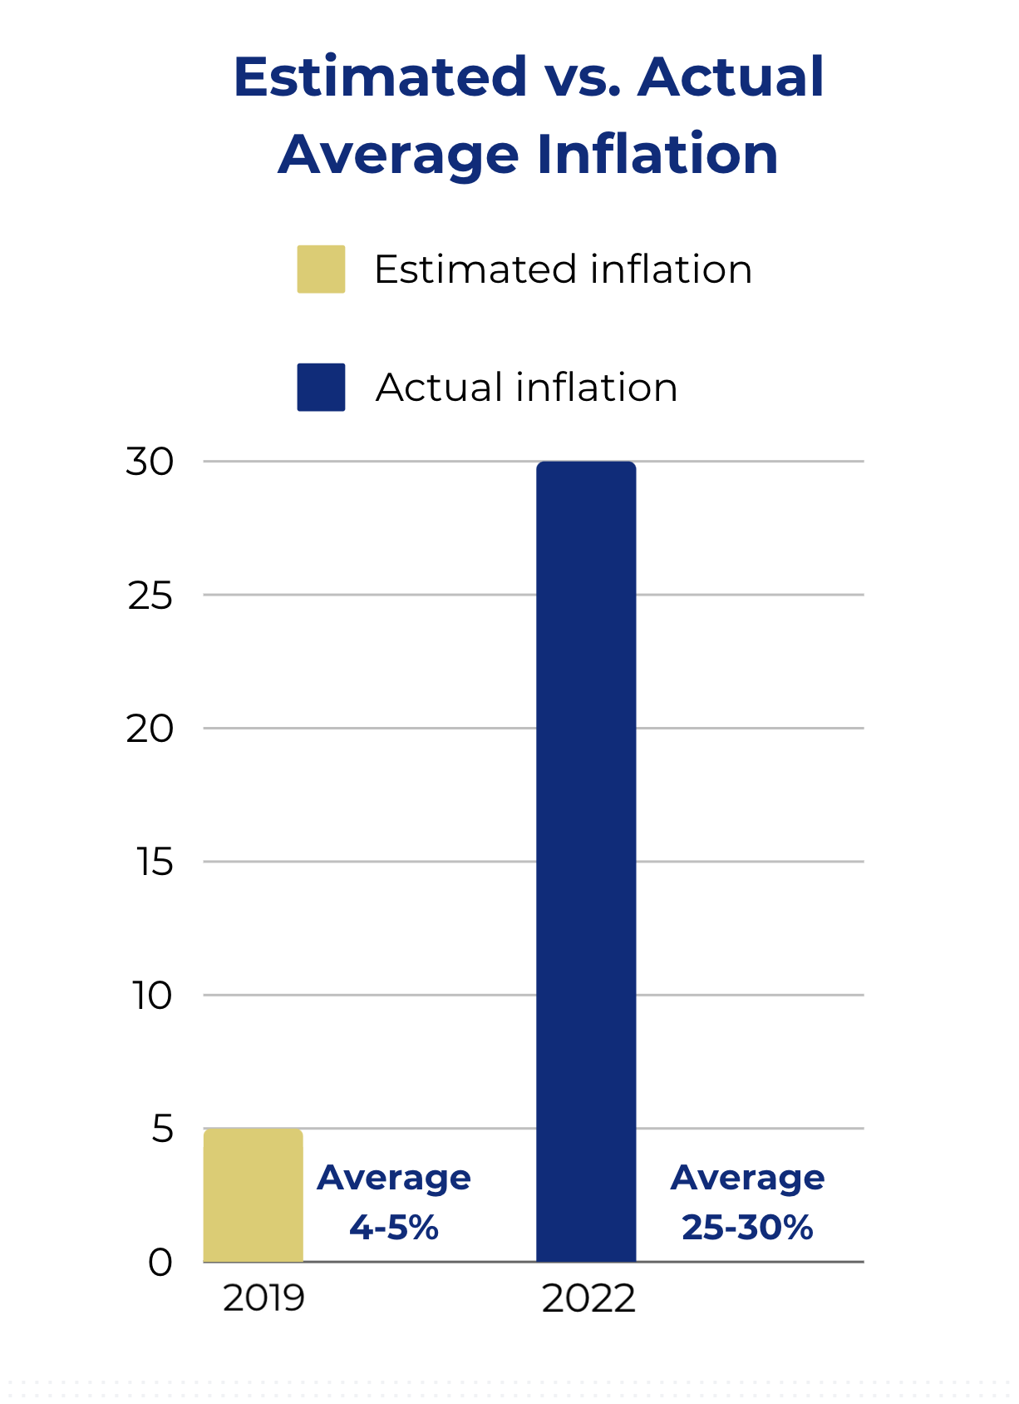
Pandemic Impacts
And then the global pandemic
hit, bringing with it significant construction pressures:
Unprecedented inflation
Average of 25-30%
Preliminary estimates for all projects came in over budget
Supply chain issues
Labor shortages

Slide 6
District Response
A tremendous amount of work went into salvaging Bond 2020:
Bond expenses examined at a program and a project level to identify savings
A number of program-wide cost-saving measures implemented
Example: project start dates staggered through phasing
Every major renovation project reviewed to get as close to budget as possible

Slide 7
How Can Bond Funds Be Used?

Slide 8
Rightsizing Impact
In 2023, the Board of Trustees voted on a plan to consolidate SAISD schools
Ripple effect on the bond program
7 of the campuses to be consolidated were slated for renovations (leaving 29 major renovations projects)
Receiving campuses had immediate needs to accommodate larger student populations

Slide 9
Funds From Canceled Bond Projects
Funds returned to the overall bond program for areas of critical need across the district, including at campuses receiving students through Rightsizing
The Bond 2020 Citizens Advisory Committee supported the use of returned bond funds for the following priority areas:
HVAC
Security upgrades
Restoration of scope to address critical needs

Slide 10
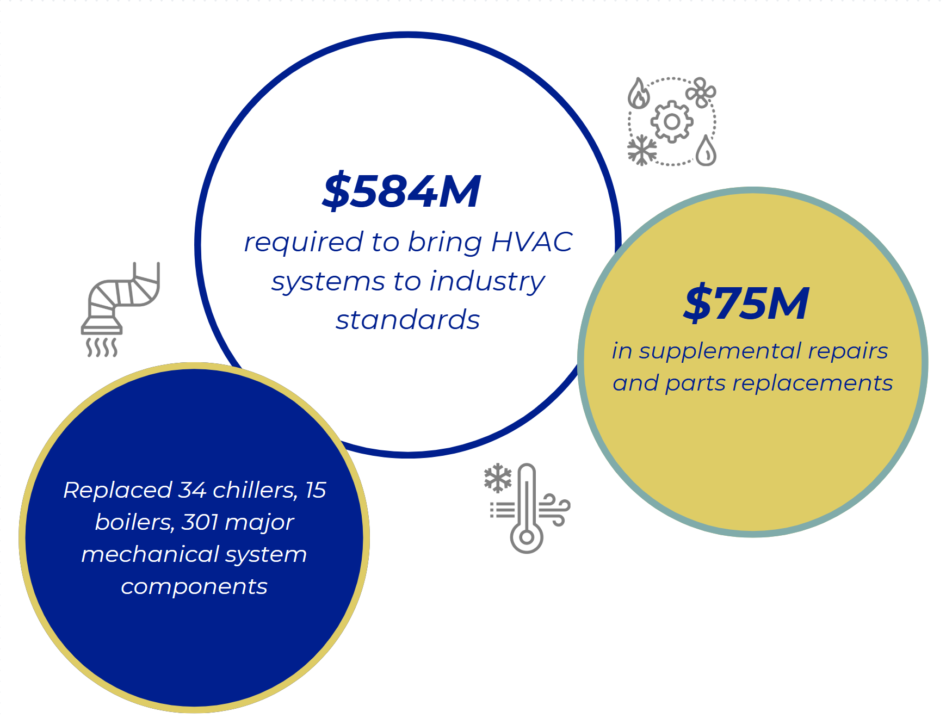
Significant HVAC Needs

Slide 11
Where We Are Today

Slide 12
Breakdown of Project Costs

Slide 13
Brackenridge HS: Current Project Scope & Budget
Total Budget*: $41.4 million
Phase 2
Project
Scope:
New dance studio
New competition gym
Renovate existing competition gym to a secondary gym
Major interior renovations to athletic facilities
Add new canopy connecting the gyms
Complete HVAC upgrades
Improve baseball and softball fields
Targeted completion:
Winter 2025
*Includes architectural, engineering, surveys, permits, construction costs and FF&E

Slide 14
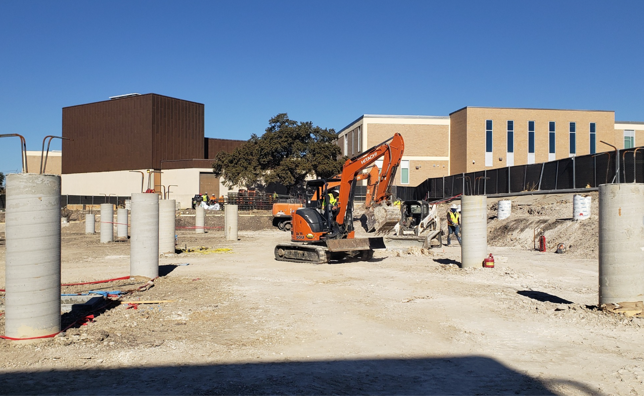
Brackenridge HS Project Status
Overall project: 70% complete
Existing gym renovation: Renovation completion in April 2025
HVAC upgrades: Completion for buildings D, E, & F in November 2025
New competition gym: Completion in December 2025 New dance studio: Completion in December 2025
Baseball and softball fields: To begin in later phase of project

Slide 15
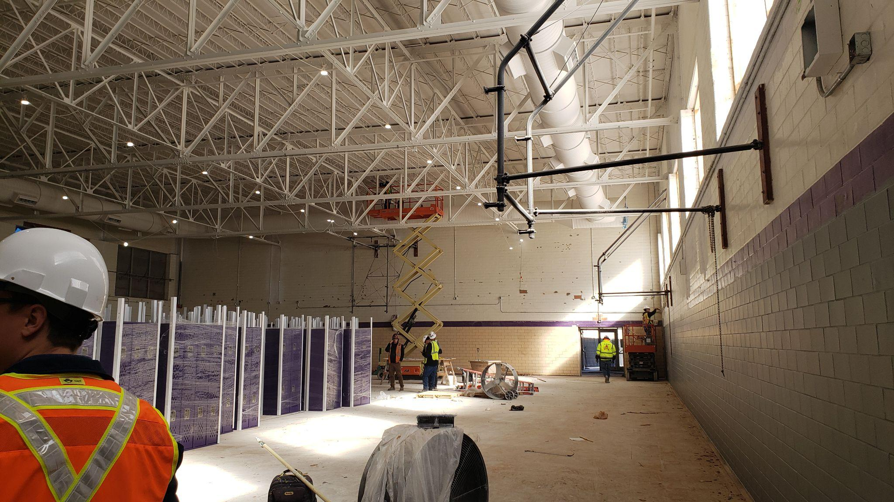
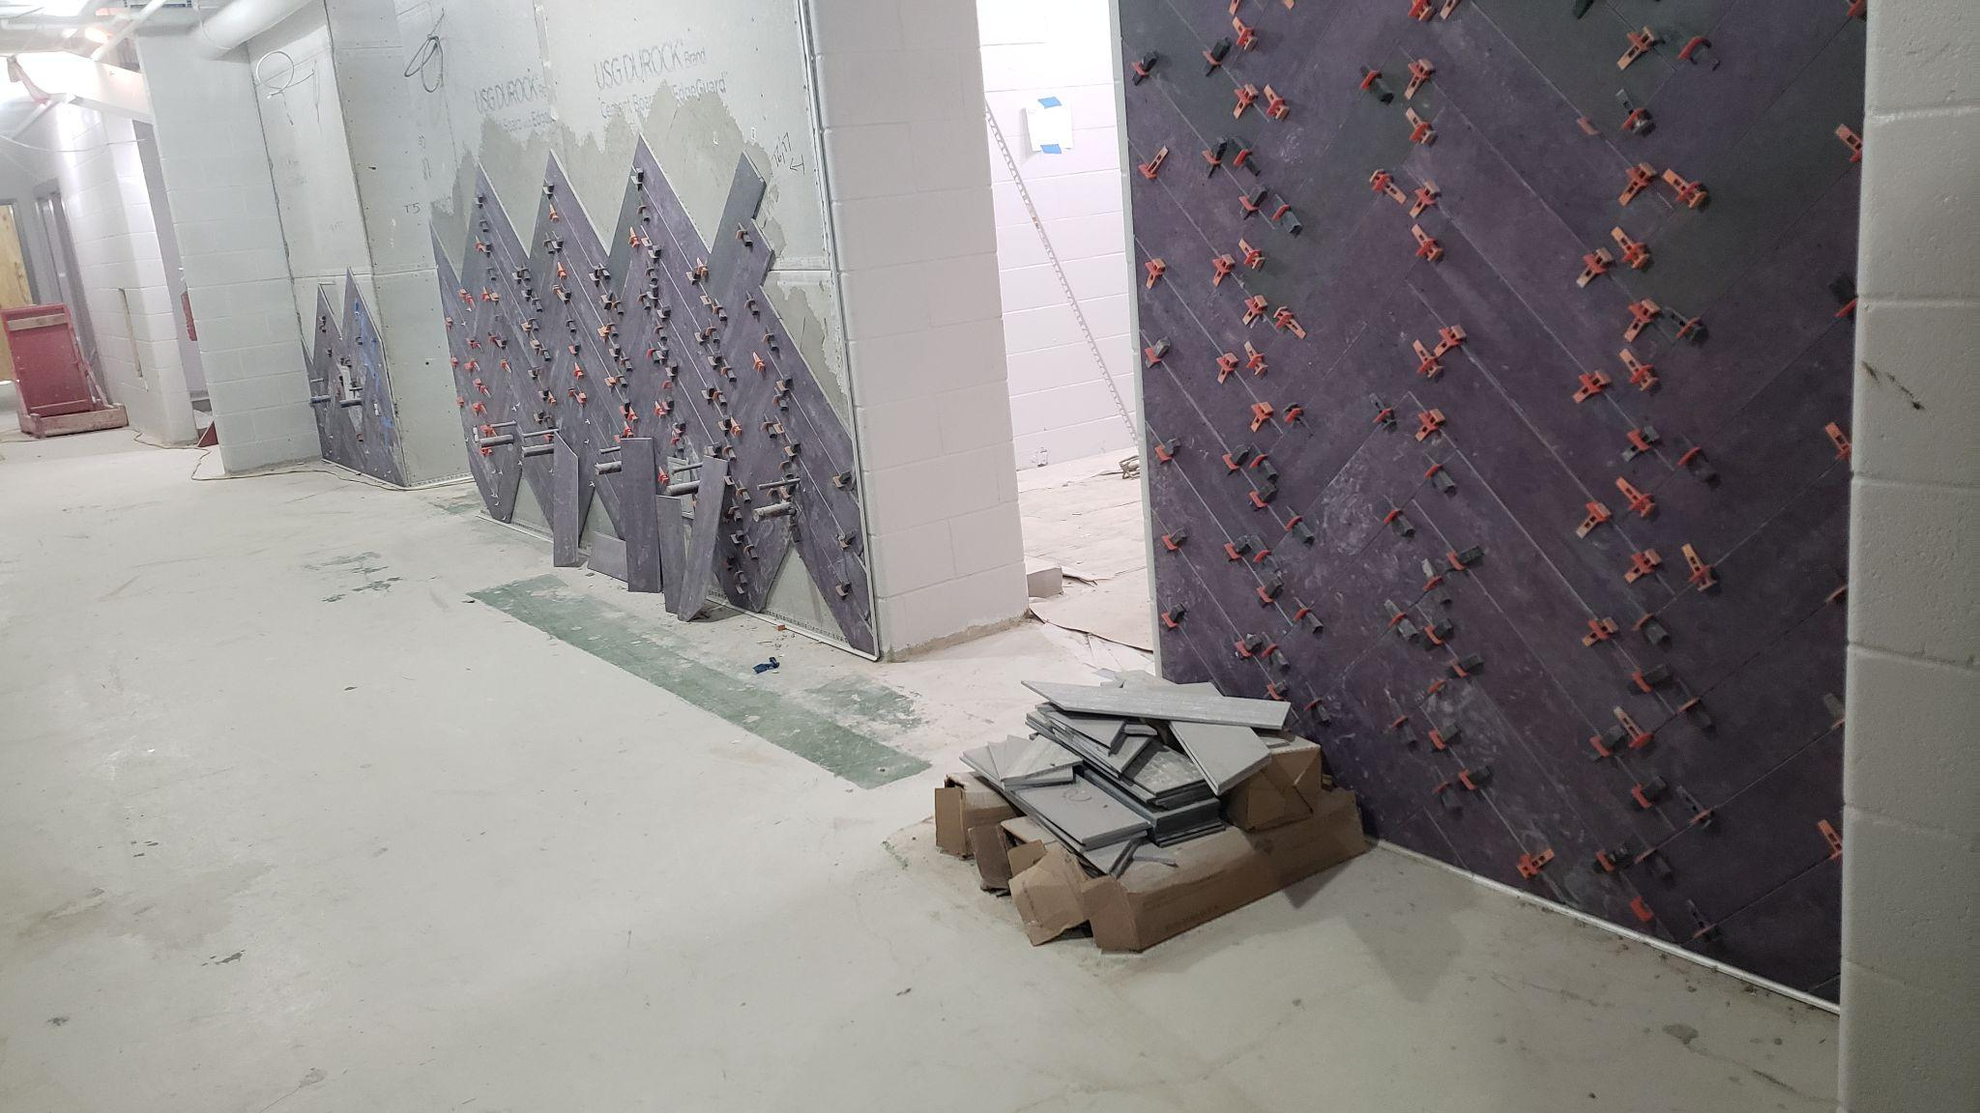
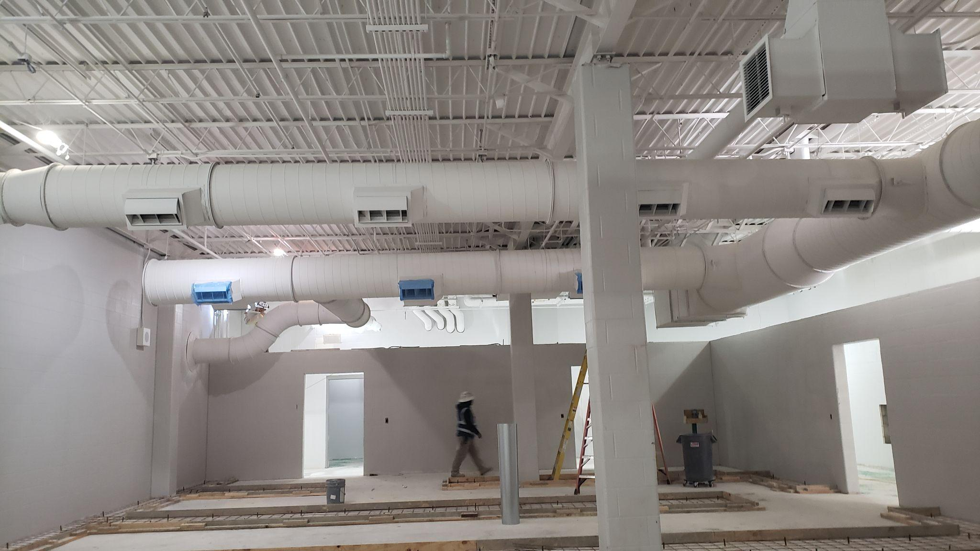
Brackenridge HS Project Status

Slide 16
Fox Tech HS: Current Project Scope & Budget
Total Budget*: $81.3 million
Phase 2
Project
Scope:
Construct new performing arts building
New black box theater
Renovate competition and secondary gyms
Targeted completion:
Summer 2027
*Includes architectural, engineering, surveys, permits, construction costs and FF&E

Slide 17
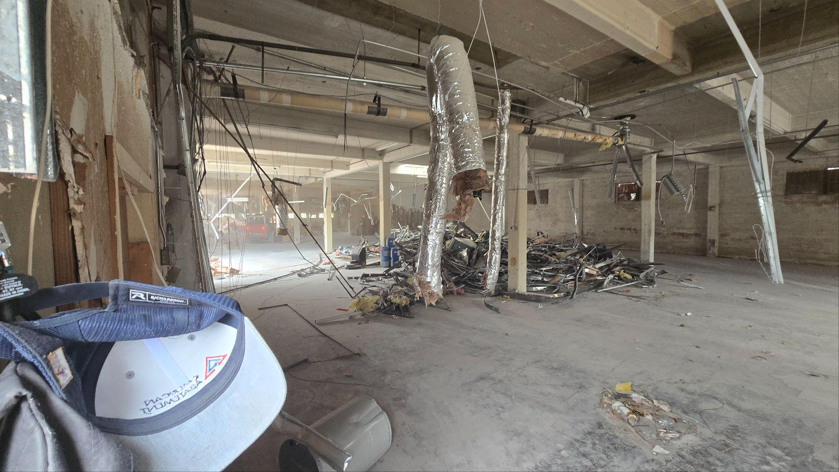
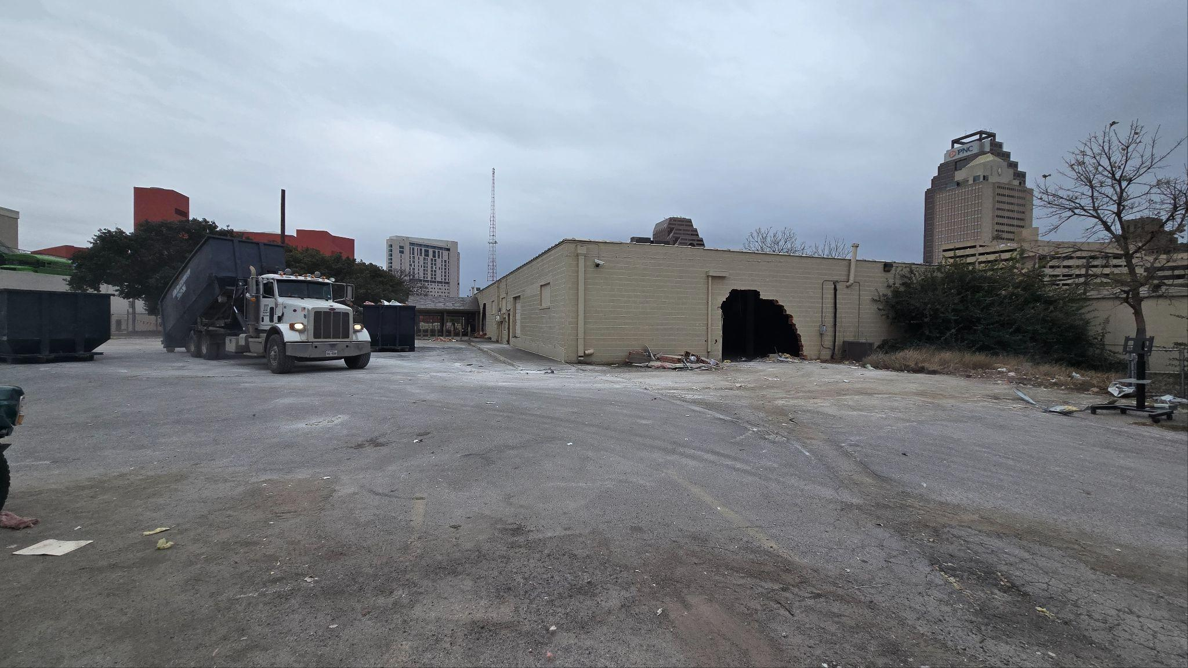
Fox Tech HS Project Status

Slide 18
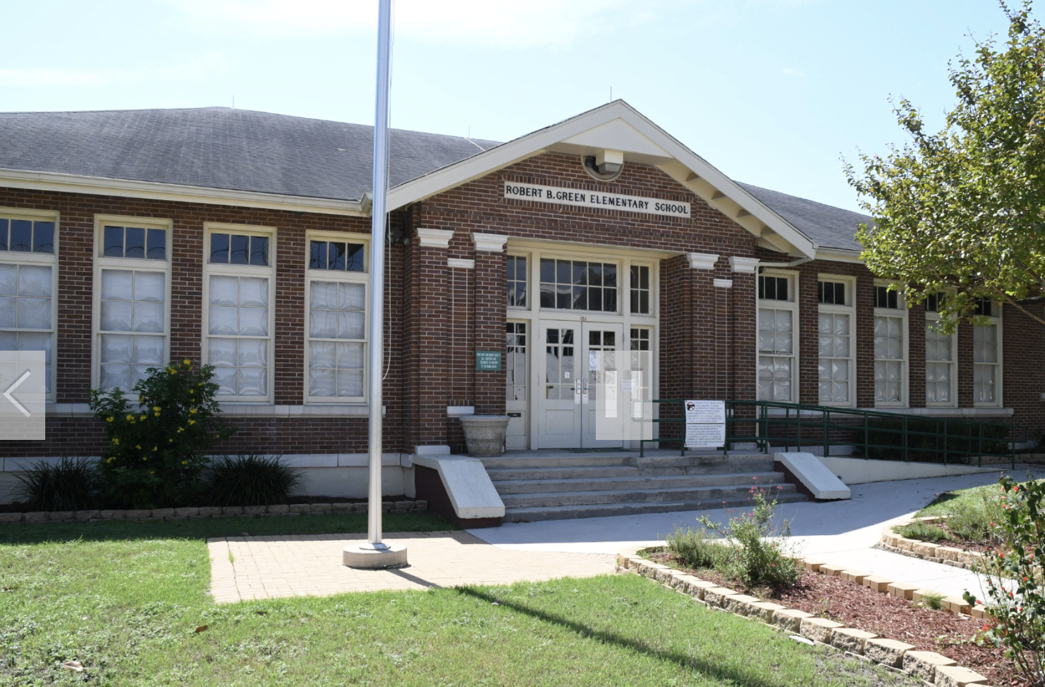
Bonham Primary: Current Project Scope & Budget
Total Budget*: $16 million
Project Information:
Project scope to be revisited due to relocation of primary campus to Green Elementary (versus Burnet facility)
Campus programming needs to be identified
Project Advisory Team (PAT) to be created
Budget allocation may be adjusted after programming needs/facility improvements determined.
Original allocation was based on renovation of Burnet facility
*Includes architectural, engineering, surveys, permits, construction costs and FF&E

Slide 19
Next Round of Rightsizing
In May 2024, the Board of Trustees requested recommendations for next round of Rightsizing
SAISD still has more schools than it needs for current student population of about 44,000
Kicking off Master Plan 2045 to guide future downsizing efforts

Slide 20
About the Master Plan
Master Plan 2045 will provide significant data for each SAISD facility

Slide 21
Next Steps
Kick off the facility master planning process to chart a new way forward for facilities in SAISD
Capital Development & Construction Services will be following up with principal to discuss formation of Project Advisory Team (PAT).

Slide 22
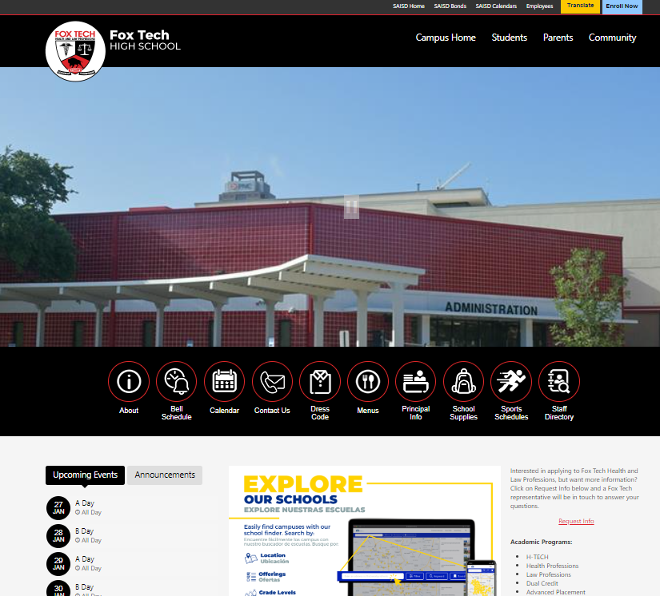
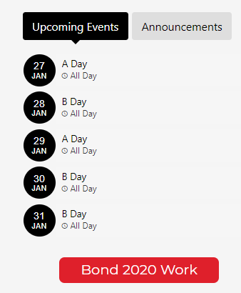
Bond Update & News
Bond.saisd.net For individual project updates, upcoming events, and more
Campus website Quick link to your school’s bond page via your campus homepage
Social media Follow SanAntonioISD on Facebook, Instagram, and LinkedIn for bond progress and event info

Slide 23
Questions

